Slide 1

CISC 250 –
Business Telecomm Networks
Switched LAN

Slide 2
Today’s Outline
Switched LAN
  Switch Operation
  VLAN

Slide 3
Switch
Link layer device
  stores and forwards Ethernet frames
  examines frame header and selectively forwards frame based on destination MAC address
  when frame is to be forwarded on segment, uses CSMA/CD to access segment
transparent
  hosts are unaware of presence of switches
plug-and-play, self-learning
  switches usually do not need to be configured

Slide 4
Ethernet Switching Table
Switching Table
Port Station
A1-44-D5-1F-AA-4C
B2-CD-13-5B-E4-65
C3-2D-55-3B-A9-4F
16 D4-47-55-C4-B6-9F
Ethernet Switch
UTP
15 C3-2D-55-3B-A9-4F
D4-47-55-C4-B6-9F
UTP
UTP
On Port 16
UTP
Frame
Frame
C3-2D-55-3B-A9-4F
A1-44-D5-1F-AA-4C
B2-CD-13-5B-E4-65
On Port 15
On Port 10
On Port 13

Slide 5
Switch: traffic isolation
switch installation breaks subnet into LAN segments
switch filters packets:
  same-LAN-segment frames not usually forwarded onto other LAN segments
  segments become separate collision domains
switch
collision
domain
hub
hub
hub
collision domain
collision domain

Slide 6
Switches: dedicated access
A
Switch with many interfaces
Hosts have direct connection to switch
No collisions; full duplex
Switching: A-to-A’ and B-to-B’ simultaneously, no collisions
  → Better performance, higher speed
C’
B
switch
C
B’
A’

Slide 7
Institutional network
Broadcast domain
mail server
to external
network
router
web server
switch
IP subnet
hub
hub
hub

Slide 8
Problems with switched LAN
Broadcast domain
  Group of network devices that will receive LAN broadcast traffic from each other
  Switches cannot break up broadcast domain
    Routers can!
Security concerns
  LANs often have confidential, mission-critical data moving across them
Performance concerns
  Broadcast traffic can degrade network performance if not properly managed
Management concerns
  Moves, adds, and changes of workstations due to reorganization

Slide 9
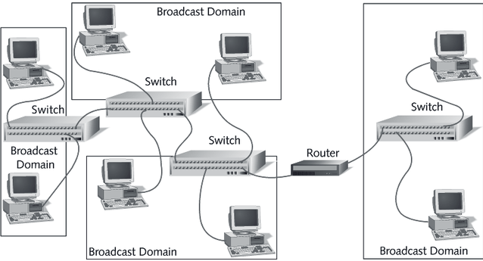
Virtual LAN
Figure 13-10: Broadcast domains using VLANs
YouTube video “VLAN Concepts” https://www.youtube.com/watch?v=2hUUaG4o3DA

Slide 10
Virtual LAN
Virtual LAN (VLAN)
  Grouping of network devices that is not restricted to a physical switch
  Frames are tagged according to LAN membership, e.g., VLAN1 (default), VLAN2, and VLAN3
  Ethernet switch establish broadcast domains according to the defined VLAN boundaries (ports are assigned to each VLAN)
Routers are used to inter-connect multiple VLANs
  On multiple interface or on a single interface
  Devices cannot communicate between VLANs without a router
  Each VLAN has its own IP subnet address

Slide 11
Benefit of VLANs
Administrators can divide LANs logically without changing actual physical configuration
  e.g., assign a switch port to a VLAN using Cisco Network Assistant (CNA)
  https://www.youtube.com/watch?v=WMbXgtxTrBY
  This provides administrator with several benefits:
    It is easier to add and move stations on the LAN
    It is easier to reconfigure the LAN
    There is better traffic control
    There is increased security

Slide 12
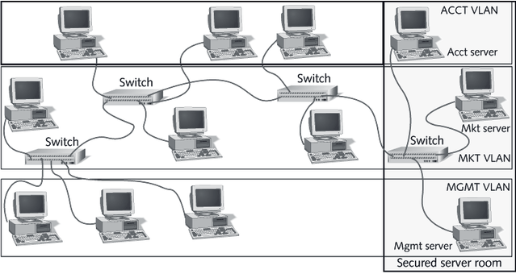
Benefit of VLANs
Figure 13-11: Securing servers with VLANs

Slide 13
VLAN
Modern campus network architectures are tending to move away from traditional router-for-a-building design, to VLAN designs.

Slide 14
Old Design Included a lot of Routers
routers

Slide 15
New Design Includes VLAN Router
Router with VLAN support
Switches with VLAN support

